Slide 1

Machine Learning-Based Phishing Website Detection
Group 13 – IAS Project | Arizona State University
Team Members:Aishwarya Srivastava – Team Leader (Feature Engineering & Coordination)Adam Nachtrab – Deputy Leader (Data Analysis & Preprocessing)Razan Alshehri – System Design & ArchitectureCephus Agassi – Feature Extraction & Model IntegrationDiveet Kaushik – UI/UX & Browser Extension

Slide 2

Project Overview
Our mission is to develop an intelligent machine learning–based phishing detection system that identifies malicious URLs in real time and provides immediate user alerts, protecting online security at scale.
Extract Features
Train Models
Derive meaningful URL and website content characteristics
Implement Random Forest, XGBoost, and SVM algorithms
Detect Threats
Learn Adaptively
Create browser extension for real-time detection
Enable continuous improvement through user feedback

Slide 3

System Architecture
Our three-layer architecture seamlessly integrates user-facing components with powerful backend processing and intelligent data management for comprehensive phishing protection.
Database & Feedback Loop
ML Backend Service
Stores user feedback and automatically retrains models for improved detection
Browser Extension
Extracts advanced features and predicts URL legitimacy with high accuracy
Captures URLs from user browsing and delivers instant phishing/safe alerts

Slide 4
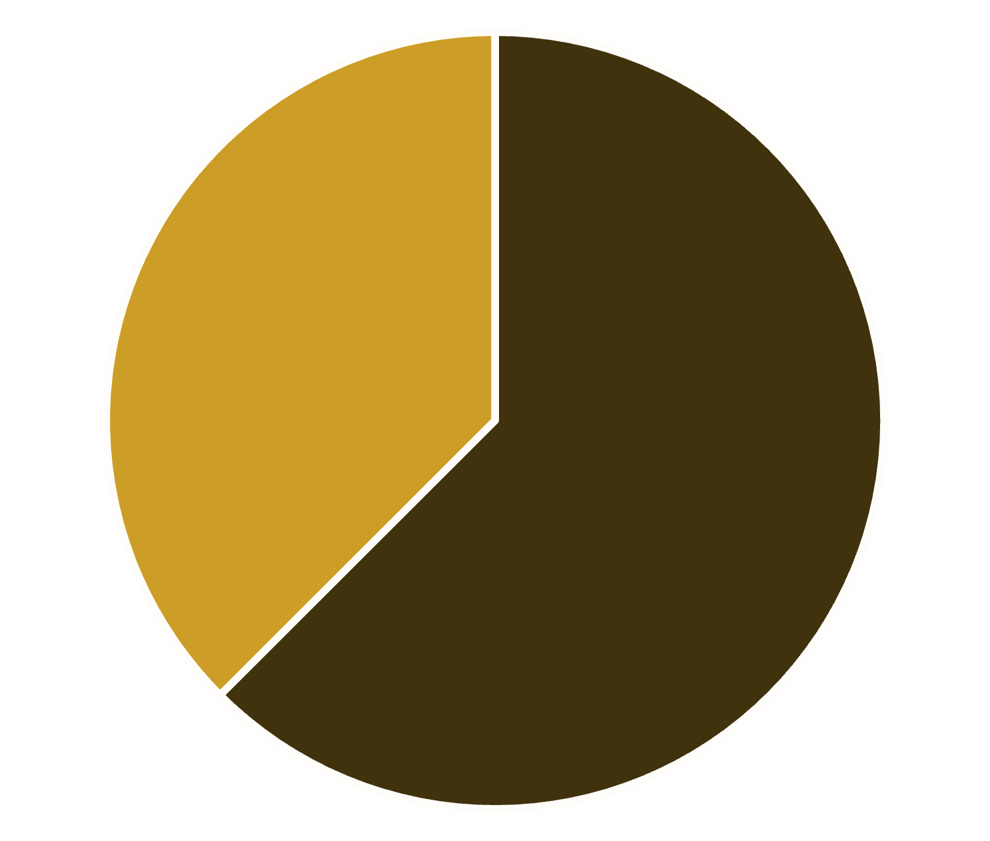
Progress Update
Completed Tasks:
Collected data from OpenPhish (phishing) and Tranco (legitimate).
Built combined dataset: 800 URLs (500 legit, 300 phishing).
Extracted 22 URL-based features (e.g., URL length, HTTPS usage, special chars).
Created processed dataset: url_features.csv.
Dataset Summary (Visual Chart) in next slides:
Chart showing label distribution (Phishing vs Legitimate).
Small table with top 5 numeric features by variance.
Legitimate
Phishing

Slide 5

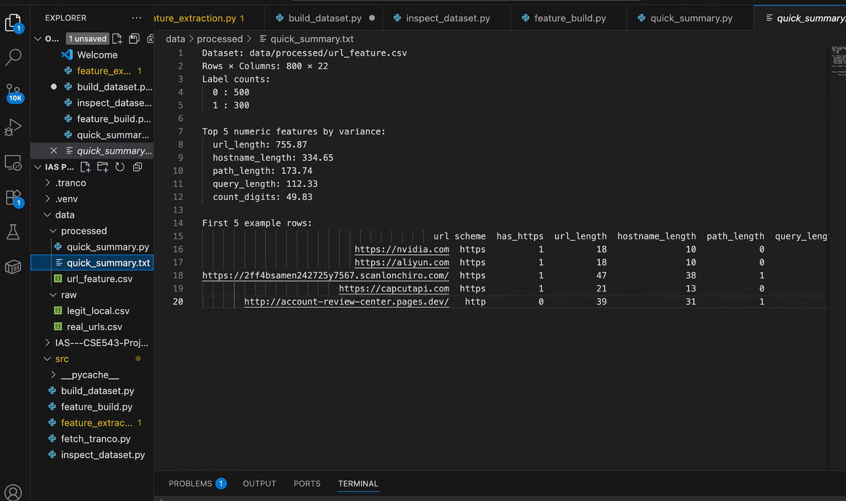
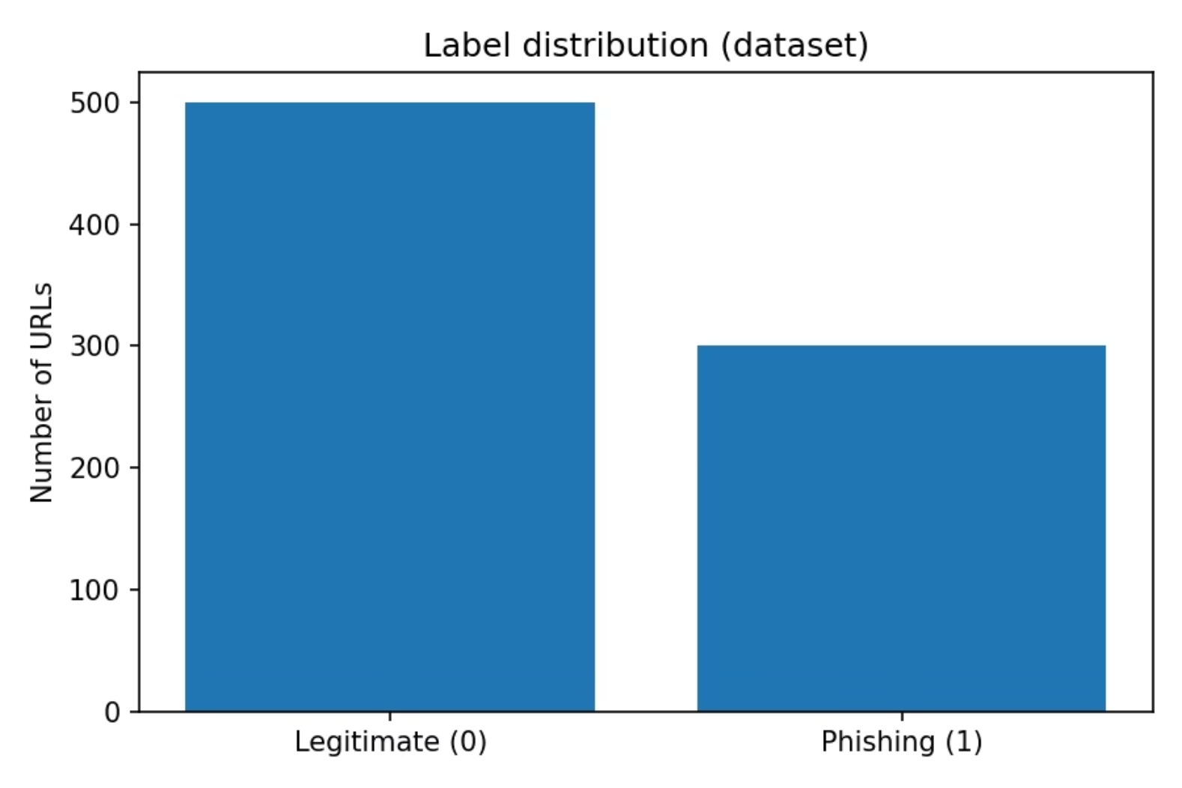
Feature Engineering Excellence
We extracted 22 URL-based features with careful statistical analysis, identifying the most discriminative characteristics that distinguish phishing attempts from legitimate websites.

Slide 6

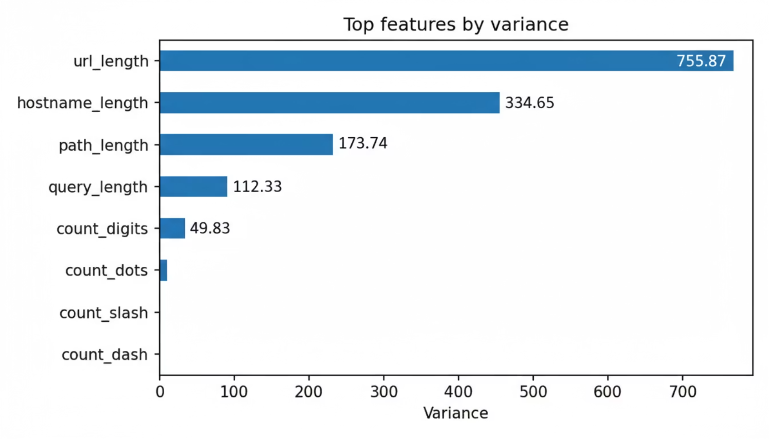
Key Milestones Achieved
Feature Extraction Module:
Implemented URL-based feature extractor in Python.
Top 5 high-variance features (visual bar chart):
URL Length (755.87)
Hostname Length (334.65)
Path Length (173.74)
Query Length (112.33)
Digit Count (49.83)
Processed File:data/processed/url_features.csv

Slide 7
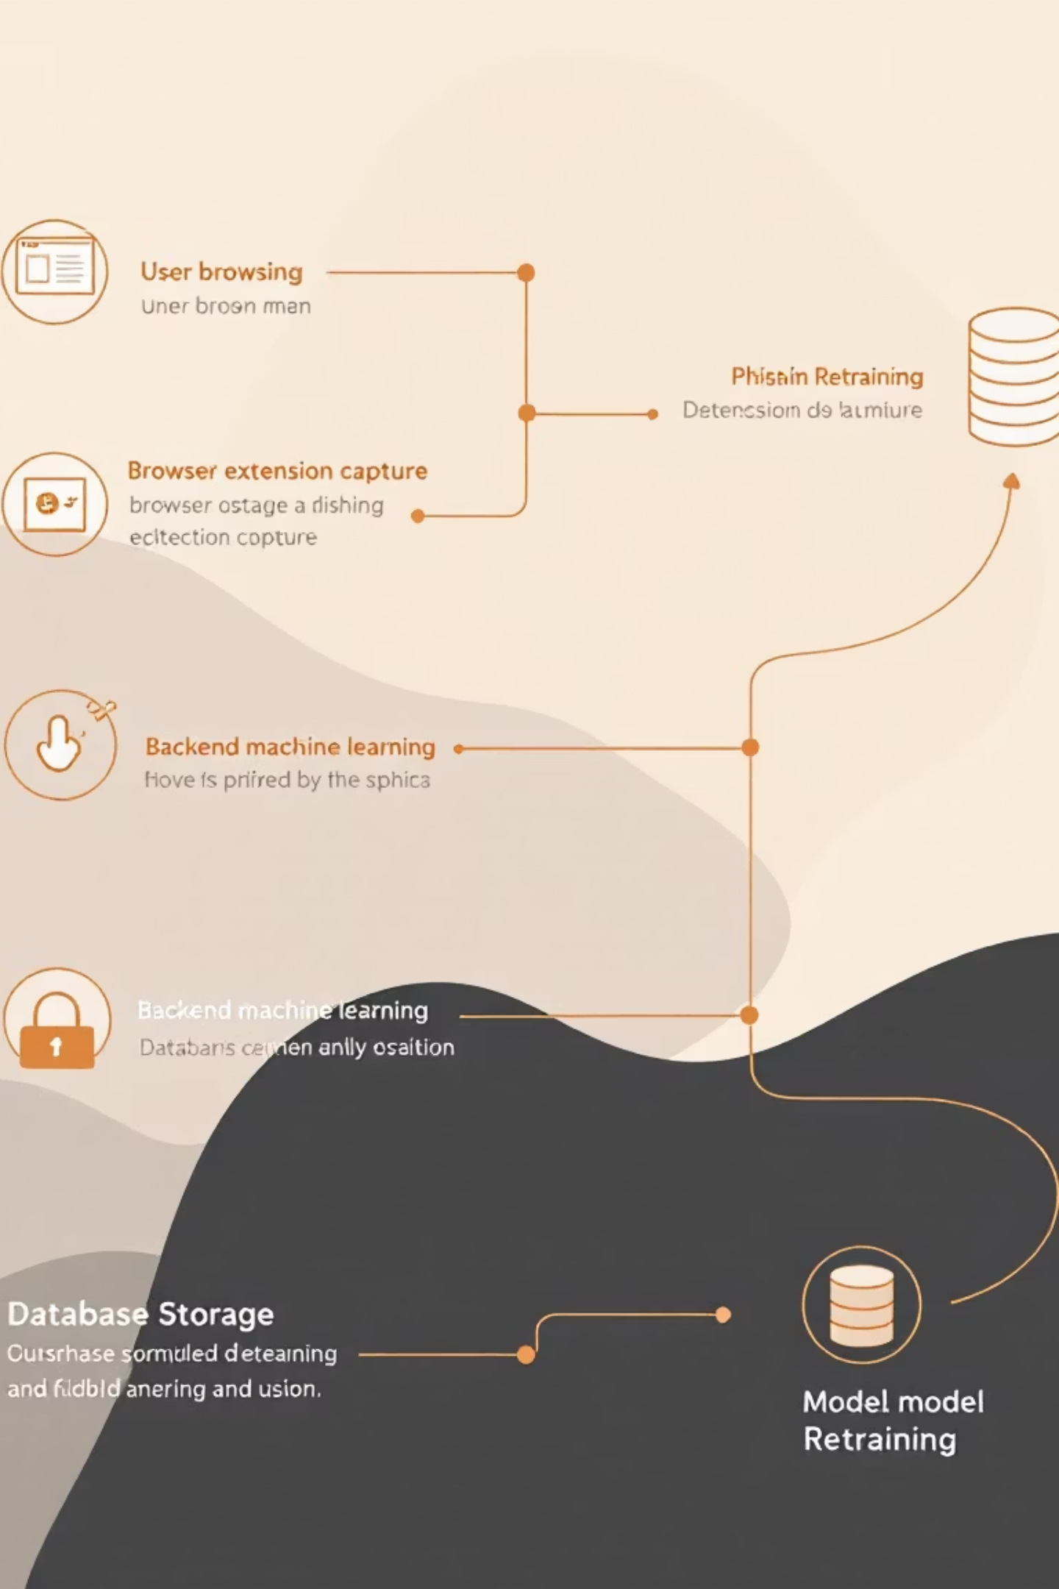

System Workflow
Our end-to-end pipeline orchestrates seamless data flow from user action through intelligent detection and adaptive learning, creating a responsive security system.
User (Browser)
Browses websites
Browser Extension Layer
Captures URL, Sends request, Displays alert, Collects feedback
Backend ML Service
Feature Extraction (URL, SSL, keywords), ML Model (RF, XGBoost, SVM), Returns prediction via API
Database Layer
Stores user feedback, Tracks model performance, Supports retraining

Slide 8

Technical Challenges
Several obstacles require strategic solutions to achieve production-ready performance and comprehensive protection across diverse phishing techniques.
Dataset Diversity
Content Integration
Expanding multilingual and geographically diverse phishing URLs to improve model generalisation across regions
Incorporating SSL certificate analysis and webpage content features beyond URL-based detection
Extension Integration
Performance Optimisation
Establishing robust communication between Chrome extension and Flask backend API for seamless predictions
Minimising latency to achieve real-time response whilst maintaining model accuracy and precision

Slide 9
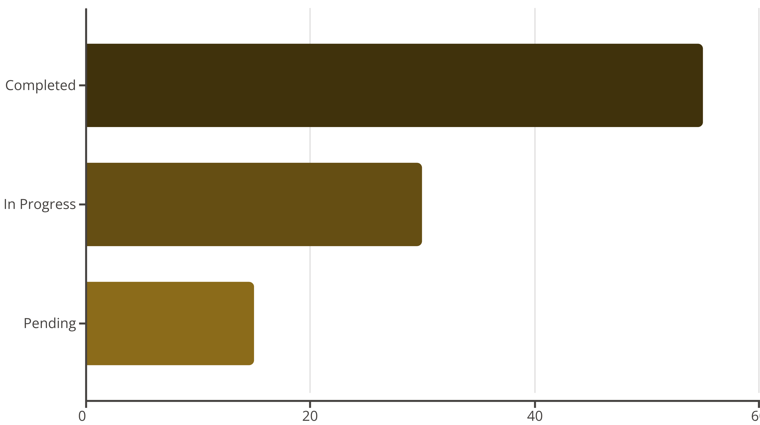
Feasibility & Roadmap
With our solid data foundation and complete feature pipeline operational, we are well-positioned for successful model deployment. Remaining work is clearly defined and achievable within project scope.
Completed
Remaining
Literature review
Model training & validation
Data collection
Flask API deployment
System design
Chrome extension UI
Feature extraction
Feedback retraining loop

Slide 10
Project Timeline
Our structured development schedule progresses through five carefully planned phases, with Phase 3 currently underway and subsequent phases commencing on schedule.
Phase
Task
Deadline
Status
Phase 1
Literature Review & Data Collection
10/10/2025
✅ Complete
Phase 2
System Design & Feature Extraction
10/25/2025
✅ Complete
Phase 3
Model Training & Validation
11/10/2025
🕐 In Progress
Phase 4
Browser Extension & Integration
11/20/2025
🕐 Upcoming
Phase 5
Final Report & Submission
12/01/2025
🕐 Pending

Slide 11

Conclusion & Next Steps
Our intelligent phishing detection system combines machine learning precision with real-time browser protection, delivering a scalable, adaptive solution for secure online browsing that evolves with emerging threats.
Finalise Training
Deploy API
Document & Share
Complete model evaluation with comprehensive performance metrics
Integrate Flask backend with Chrome extension for production use
Publish complete workflow documentation on GitHub

